Slide 1
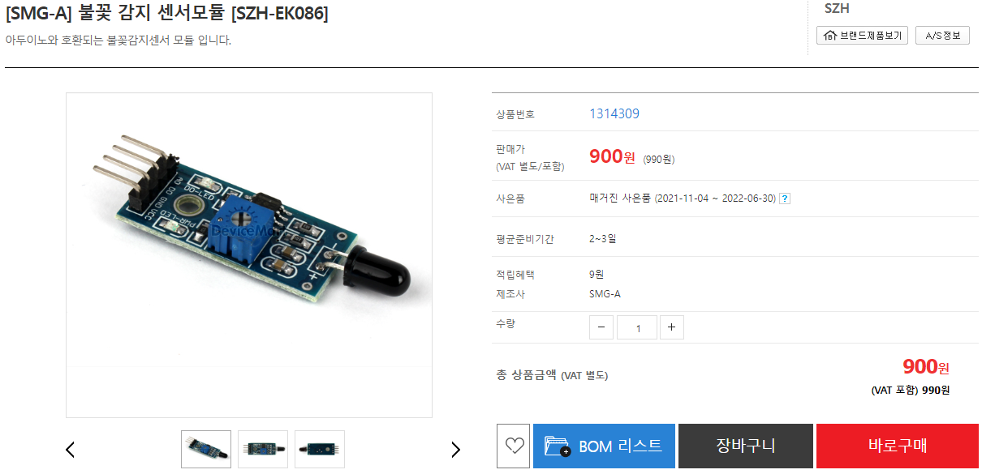

Slide 2
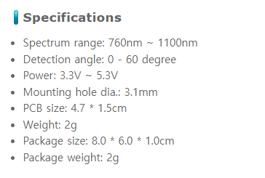
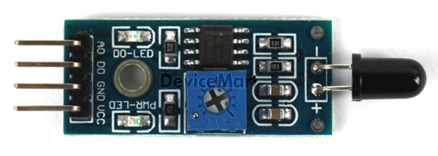
화염 불꽃 감지센서

Slide 3
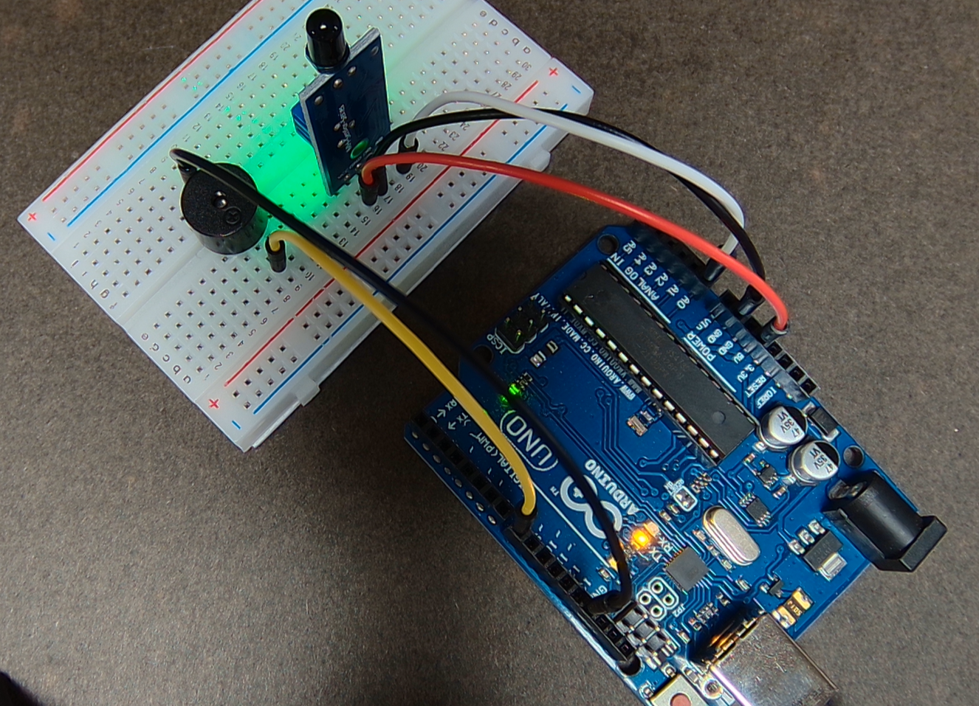
화염 불꽃 감지센서

Slide 4
화염 불꽃 감지센서
예제코드: Fire_02
const int SENSOR = A0;
const int BEEP = 8;
void setup() {
Serial.begin(115200);
pinMode(SENSOR, INPUT);
// 부저
pinMode(BEEP, OUTPUT);
}
void loop() {
int value = analogRead(SENSOR);
Serial.print("Sensor = ");
Serial.println(value);
if(value<900) {
digitalWrite(BEEP,HIGH);
delay(500);
digitalWrite(BEEP,LOW);
delay(500);
}
}

